Slide 1
Offering quality consulting & management services to the medical community…
Rural Health Clinic Updates, Compliance, and Maintenance
Presented by Mark Schultz
mschultz@mwhc.net www.mwhc.net
Notes:
Thank you everyone for coming!
Who came the farthest today? How many hours did you travel? 1? 2? 3? 5? … PRIZE!
How many of you have participated in an Annual Evaluation at their clinic? - PRIZE!

Slide 2
Agenda
RHC Updates
Compliance
Consolidated Appropriations Act of 2023
Emergency Preparedness
Notes:
Our agenda is simple. REVIEW SLIDE.
Question: What Title details the Annual Program Evaluation requirements? – PRIZE!

Slide 3
The End of the Covid-19 Public health Emergency
Public Health Emergency (PHE)
Originally declared January 27th 2020
Renewed every 90 days since initiation
Expires May 11, 2023

Slide 4
End of the PHE
Temporary Expansion Locations
CMS waived the requirement that RHCs be separately considered for MCR survey and certification if services were expanded into more than one permanent location
Staffing waivers
CMS waived the requirement that a NP, PA, or CNM be available to furnish patient care services as least 50% of the time the RHC is operating
Bed Count
CMS permitted provider-based RHCs subject to their clinic-specific, grandfathered upper – payment limit to increase their hospital bed count to over 50 without losing their grandfathered status

Slide 5
End of the PHE
HIPAA Notification of Enforcement Discretion
OCR will exercise its enforcement discretion and will not impose penalties on covered health care providers for noncompliance with the requirements of the HIPAA Rules in connection with the good faith provision of telehealth using non-public facing audio or video remote communication technologies during the COVID-19 PHE
Once this expires, providers can be penalized for noncompliance with HIPAA rules in connection to telehealth

Slide 6
Telehealth
Prior to PHE, RHCs were only allowed to be the originating site for Medicare Telehealth visits
During the PHE, RHCs were allowed to provide distant site telehealth
This measure was to originally end 151 days after the end of the PHE
It has now been extended through December 31, 2024
RHCs bill G2025
Cost and encounters are carved out of the cost report
Reimbursement Rate for 2023: $98.27 (lower than your All-inclusive Rate)

Slide 7
Mental health Telehealth
Prior to PHE, not allowed
Mental Health services provided via telehealth are permanently covered by Medicare in RHCs
RHCs receive their All-Inclusive Rate
Cost and encounters are included on the cost report
Occasional in-person visit requirement currently waived through December 31, 2024

Slide 8
Mental health Telehealth

Slide 9
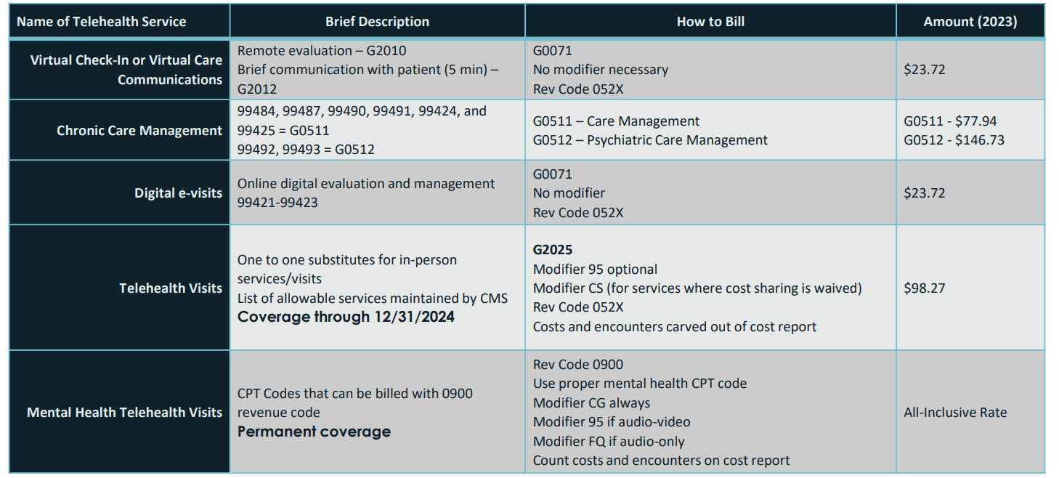
Current Telehealth Billing
Prior to PHE, not allowed
Mental Health services provided via telehealth are permanently covered by Medicare in RHCs
RHCs receive their All-Inclusive Rate
Cost and encounters are included on the cost report
Occasional in-person visit requirement currently waived through December 31, 2024

Slide 10
CONSOLIDATED APPROPRIATIONS ACT OF 2023
Omnibus Text
• Congress expanded Medicare coverage to include Marriage and Family Therapists and Mental Health Counselors
• These providers will be able to generate a Medicare encounter and be reimbursed at the RHC’s all inclusive rate
• Effective January 1, 2024

Slide 11
CENSUS UPDATE
• RHC program has used Census Bureau’s definition of “urbanized area” to determine if the site met the rurality requirement since 1977
• The census update eliminated the term urbanized area
• Urbanized area had been defined as urban areas of 50,000 or more
Interim Process
RHC applicants or relocating RHCs will meet the rural location requirement if the physical address is “non-urbanized” or in an “urban cluster” per the 2010 Census Bureau Data, or if the physical address is not an urban area per the 2020 Census Bureau Data

Slide 12
Compliance
How to maintain compliance
Program Evaluations
Emergency Preparedness
Policy Manuals
Common Deficiencies

Slide 13
Program Evaluation

Slide 14
Why?
42 CFR 491.11(a) & (c)
(a) The clinic or center carries out, or arranges for, a biennial evaluation of its total program.
----------------------------------------------------------------------------------------------------------
(c) The purpose of the evaluation is to determine whether:
(1) The utilization of services was appropriate; (2) The established policies were followed; and (3) Any changes are needed.
- [71 FR 55346, Sept. 22, 2006 as amended at 84 CFR 51832 Sept. 30, 22019]

Slide 15
What?
42 CFR 491.11(b) & (d)
(b) The evaluation includes review of: (1) The utilization of clinic or center services, including at least the number of patients served and the volume of services; (2) A representative sample of both active and closed clinical records; and (3) The clinic's or center's health care policies.
----------------------------------------------------------------------------------------------------------
(d) The clinic or center staff considers the findings of the evaluation and takes corrective action if necessary.

Slide 16
Who
The evaluation may be completed by RHC staff; or
Through arrangement with other appropriate professionals.
The clinic’s leadership, the medical director, one mid-level and one non-clinic member, should review and acknowledge the final report of findings and recommendations or considerations for review.

Slide 17
How?
Facility Review 491.11(b)(1)
Chart Review 491.11(b)(2)
Policy Review 491.11(b)(3)
Action Plan 491.11(d)

Slide 18
The Facility Review
Predominantly accomplished by conducting a walk-through:
Preventive Maintenance
Equipment
Drugs & Biologicals
Clean & Orderly
Laboratory
Required tests
Competencies / Control logs
Emergency Kit
Emergency Drugs & Biologicals
Procedures

Slide 19
The Facility Review
Continuing the clinic walk-through:
Licensure & Certifications
Clinic
Staff
HPSA: Rural & Shortage
Construction
Disclosures
Staffing
Other*

Slide 20
The Chart Review
A representative sample of both active and closed clinical records of RHC patients.
Records system, Protection, Retention…

Slide 21
The Chart Review
(1) Record Administrative Documentation:
Compliance documents
Consent
Privacy
Release
MSPQ

Slide 22
The Chart Review
(2) Visit Documentation:
Medical Documentation
Identification & Social Data
Histories*
Allergies
Medications
Assessment, Exam
Summary of findings, plan / instructions
Disposition

Slide 23
The Chart Review
(3) Additional follow-up Documentation:
Follow-up
Diagnostic, Laboratory, Pathology test results
Referrals* (491.9(d)(2))
Signature
Complete & Accurate

Slide 24
The Policy Review
RHC Policy :
Organizational Structure
Compliance Plan
Staff Responsibilities
Services Provided & Medical management
Program Evaluation
Drugs & Biologicals Management (storage & administration)
Physical Plant & Environment
Laboratory & Emergency drugs
Medical Records Management
Emergency Preparedness

Slide 25
The Policy Review
Other Policy :
Human Resources
Financial & Billing
OCR
HIPAA
OSHA
OIG
Other*

Slide 26
The Final report
The evaluation findings must be documented in a summary report, and
Include recommendations for corrective actions to address findings.

Slide 27
Emergency Preparedness
Hazard Vulnerability Assessment (HVA)
HVAs must be done initially and reviewed biennially
Your exercise must be one of your listed items on your HVA, unless it’s an actual event
Communication plan is complete including name and contact information for all staff and local, regional, state, tribal and federal emergency staff
Must address Volunteers
Address how refrigerated meds and vaccines are handled during a power outage
All staff must be trained on the emergency plan. This includes initial training and updated training every 2 years

Slide 28
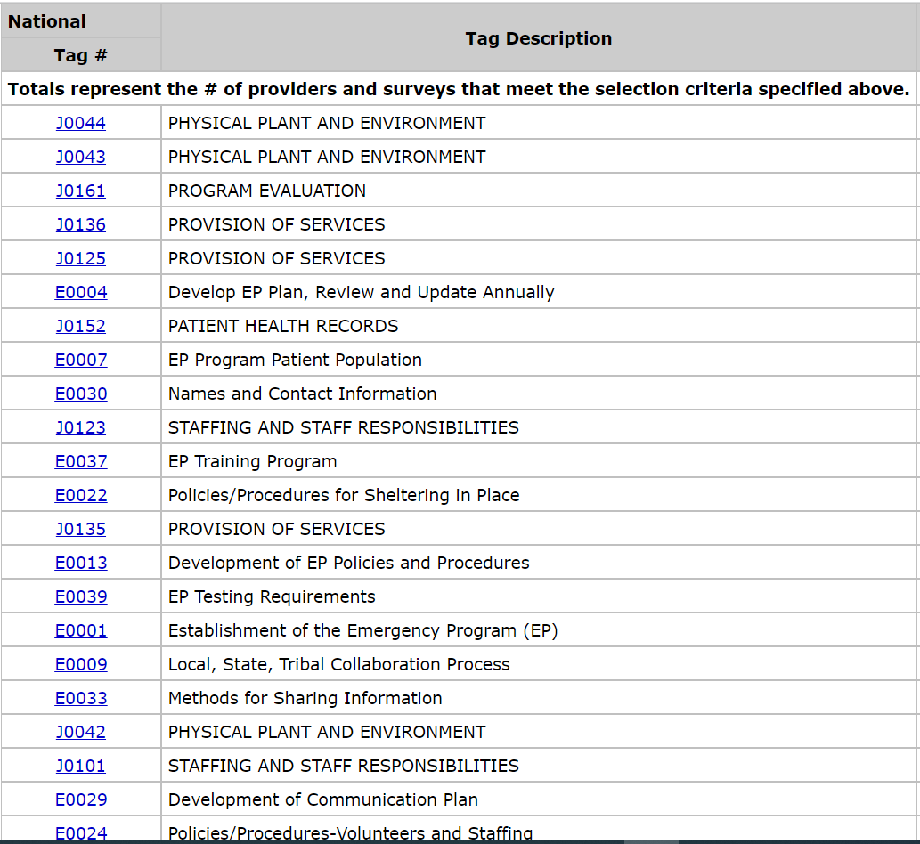
Notes:
This is a look at the latest statistics from CMS…E-tag 4 is #1 EP deficiency in 2021; which is to Develop a Plan, Review and update. Interesting E07, Patient Population, is #2. This is new. Then Names and Contact information. Also new. E0022 policies for sheltering. So, now it seems that maintenance has become some issue. Training is still showing up in the top 5. Simple ‘competency.’
CMS QCOR Survey results.
E0001 – Establish program (comprehensive approach, coordinate w/ HC facilities & community)
E0004 – Develop plan (Plan to include risk assessments, patient needs, continuity, collaboration w/ emergency officials, All-Hazards Approach)
E0006 – Plan based on All-hazards risk assessment
E0037 – Training program (initial & annual training, documentation, demonstrate knowledge)
E0036 – Training and Testing (written Training & Testing plan, based on risk assessments)
E0039 – Testing (Participate in two exercises, Analysis – AAR/IP)

Slide 29
Write a Plan based on HVA’s.
Include Policy & Procedure
Include a Communication Plan.
Training & Testing
Notes:
Your emergency preparedness program includes 4 general components in which we will take a look at each one. REVIEW…

Slide 30
Emergency Plan
Risk Assessments – HVA
Facility-based
Community-based*
EID’s
All Hazards Approach
Strategies*
Notes:
Action-items required in Part A of the reg set the framework for your EP Plan.
Your plan is established on the basis of your risk assessments and an all-hazards approach. An all-hazards approach simply focuses on identifying hazards and developing capabilities to address those hazards as well as a wide spectrum of emergencies or disasters. Two risk assessments are required, a facility-based, specific to your clinic, and a community-based.
EID’s or emerging infectious diseases… Is added to your program to encompass how you plan, coordinate and respond to a localized or widespread pandemic.
EIDs are included in your facility and community risk assessments, emphasizing the needs of your patient population.
Examples of EID’s provided in the guidance were Pandemic Flu, COVID-19, SARS-CoV-2, Hazardous waste, Ebola, Zika Virus, Bioterrorism. As usual, ‘including but not limited to.’
Fun fact: The update mentions utilizing infection prevention personnel in the planning and development phase of your plan.

Slide 31
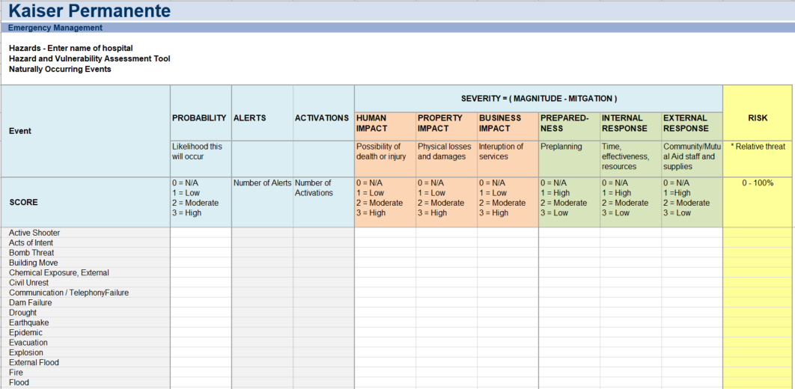
Risk assessment tool
https://www.calhospitalprepare.org/hazard-vulnerability-analysis
Notes:
Pictured, some of you may be familiar with the Kaiser Hazard Vulnerability Assessment tool. BUT, just in case…You can follow the basic idea across the event row towards the top. Identify the probability of a hazard. Input the impact of the hazard on people, property and business. Then input how prepared you are and your capability to respond internally and externally. This version also gives you a mechanism to track activations.

Slide 32
Emergency Plan
Strategies
Interruptions
Patients & Services
Delegations & Succession
Staffing & Evacuation
Cooperation & Collaboration
EIDs
Notes:
A number of strategies should be addressed in this first component. Consider Interruptions in service or communications. Other parts of the rules will address some of this, like alternate communication methods. Specify the population served in the facility. Consider unique vulnerabilities during an emergency and your patient’s needs. Consider patient and staff needs during an evacuation. Specify services the facility would be able to provide during an emergency. Business Continuity. I haven’t heard this addressed a great deal in survey, but we will talk more about it today. Business continuity or Continuity of Services, addresses the continued operation and essential functions of your facilities during emergencies or any situation that disrupts normal operations. A good continuity plan will help guide you and your organization in recovery, mitigation and reestablishment efforts.
You can find information on business continuity and recovery planning at FEMA.gov or ready.gov. Other segments of the emergency program will address business continuity, but education and research would provide information to fill in any gaps.
Delegation and Succession planning I think is fairly straight forward. Be sure to document it. We have seen deficiencies in relation to this.
Staffing, surge capacity and evacuation. Evacuation is a key component to address thoroughly in your planning.
Cooperation and collaboration…we talked about this some…ensure you have a process…
…and a new acronym from the April update: EIDs or Emerging Infectious Disease and pandemic. EID’s or emerging infectious diseases… Is added to your program to encompass how you plan, coordinate and respond to a localized or widespread pandemic.
EIDs are included in your facility and community risk assessments, emphasizing the needs of your patient population.
Examples of EID’s provided in the guidance were Pandemic Flu, COVID-19, SARS-CoV-2, Hazardous waste, Ebola, Zika Virus, Bioterrorism. As usual, ‘including but not limited to.’

Slide 33
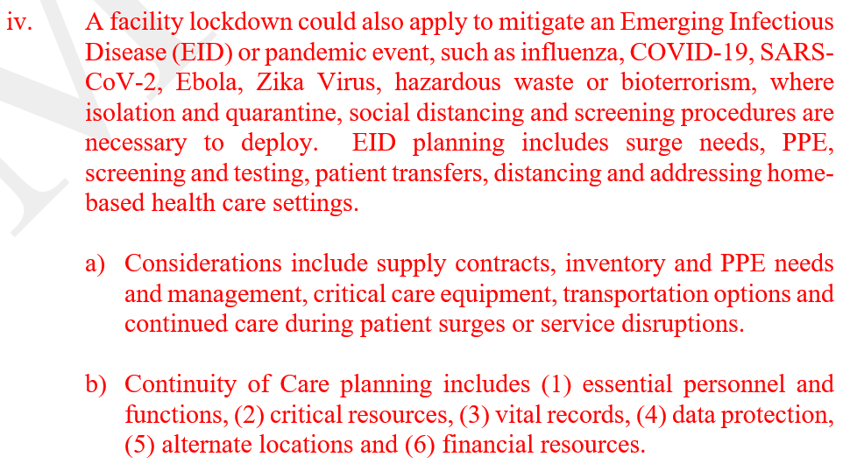
Policy & Procedure
Notes:
The next component is Policy and Procedure. I’ve included an excerpt from our policy to illustrate how we’ve integrated certain parts. These should align with any hazards identified in the HVA. In other words, don’t have a 100-page policy for handling Hurricanes (click 4 pic) when you’re located in the midwest; and make certain you’ve considered the top hazards you identify in your risk assessments.

Slide 34
Policy & Procedure
Access
Evacuation & Shelter
Responsibilities
Transfers
Medical Documentation
Volunteers
EIDs, Continuity, Surge
Notes:
This list includes categories you must include in the development of your clinic’s plan. Review List. A couple different concepts for accessibility…
In the interpretive guidelines, it stipulates the requirement of on-site access of the emergency program. So be sure that accessibility is a consideration you take into account.
Evacuation was also mentioned in Part A of the reg, again, it’s important to include in your program. SHELTER in place as well. I recommend adding it to egress plans displayed in the clinic to further demonstrate it as part of your plan. Include treatment needs of evacuees and meeting locations. You could add assembly sites in your egress plans. Just a thought.
Staff Responsibilities are important not only to establish in your policy, but to ensure individual training is adequate to ‘demonstrate knowledge,’ of your clinic’s plan. Have policy and procedure on who, how and when off-duty staff would be contacted.
The needs of their patient population to plan for what designated transportation services would be most appropriate. Definitely something to include in your contacts for communication planning.
A system to preserve medical records and continuity of care. In addition to any existing requirements for patient records, facilities are required to ensure that patient records are secure and readily available to support continuity of care during an emergency.
You should have a plan for volunteers in your program, and how or what capacity they would be used. I addressed it from both angles… accepting and/or being the volunteer.
EID’s, continuity and surge, we will talk about in a minute.

Slide 35
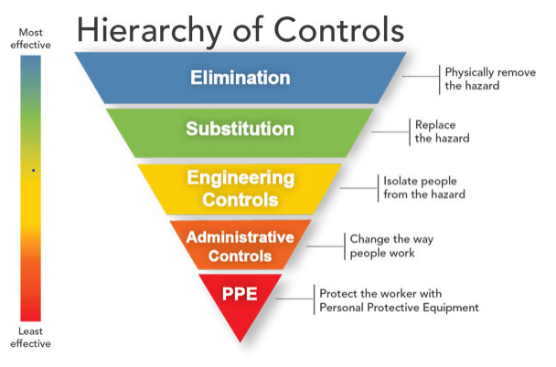
Emerging Infectious Disease
Plan development strategies–
Mitigation
Infection & Source control
Distancing / Isolation
Home-based settings
Notes:
Plan development strategies provided in the update include PPE needs, specifying, during a surge or shortage, Screening / testing, Transfers, Distancing or Isolation and home-based health care settings.

Slide 36
Policy & Procedure
Surge Planning
Notes:
Surge planning. Surge planning should include a general plan that outlines the roles and responsibilities of the individuals in succession plans.

Slide 37
Surge Planning
Evacuations
Staffing
Transfers
Protect health care personnel
Preserve system functioning
Minimize transmission
DISRUPTION
Notes:
Planning developments in your Surge plans… REVIEW slide…These all circle around to other parts of your plan potentially…staffing and system functioning to succession, minimizing transmission to PPE, infection control protocols..
Surge plans are brought up frequently in this new update. The main focus in your surge plans include evacuation, staffing and patient transfers, and the goals of your surge plan should address protections of health care personnel, preserving system functioning and minimizing transmission.

Slide 38
Continuity of Care
Surveyors are asked to verify plans to address services needed that cannot be provided by the facility during an emergency…
Contracts
Inventory, PPE, Critical care equipment, Transportation, Surge
Planning
Essential personnel and functions, Critical resources, vital records, data protection, alternate locations, financial resources
Notes:
Continuity of care…
Surveyors are asked to verify plans to address services needed that your facility can’t provide during an emergency. Not new, but emphasized in the update.
Contracts…Be prepared to continue care safely when a contract isn’t fulfilled during an event and those listed were specified in the update. Inventory, PPE, Critical equipment, transportation and surge considerations.
I’ve listed the planning items specifically mentioned… If I didn’t already mention it, ready.gov has a business continuity table on their website that creates a nice compact plan, including many of these listed like your essential personnel and functions.

Slide 39
Communication Plan
Internal - Facility
Staff, Volunteers, Providers, entities
providing services
External - Other facilities & agencies
Federal, State, tribal, regional and local
emergency staff
Other RHC’s and facilities
Needs; ability to provide assistance
Alternate communication
Include procedures regarding when and how communication methods are used and who will use them. - E0032 SOM App Z
Notes:
The communication plan in 491.12(c) primarily defines how your facility will coordinate and communicate; which I like to approach as internally and externally. Internal communications include staff, providers, volunteers and patients. External, with other like-facilities and emergency agencies or persons and vendors.
Clinic needs and your Ability to provide assistance to other facilities or agencies are reporting considerations lending toward your cooperation and collaboration with those facilities and agencies.
Last, but not least, you are required to plan an alternate communication method in case of primary communication disruption. I’m sure you’ve heard and talked about this before. Many clinics name cell phones as their alternate. You can read some of the suggestions made in appendix Z, tag E032.
A couple points, it’s important to have your listings accessible. That means printed versions in addition to digital access. We have experienced deficiencies for clinic’s that couldn’t produce a list of emergency contact information for clinic personnel; as well as not being able to provide a list for emergency agencies or other healthcare facilities.

Slide 40
Monitoring and Reporting
Notes:
Another policy exceprt…REVIEW…Monitoring HHS, CMS, CDC, DHS, Assistant Secretary for Preparedness and Response Technical Resources, Assistance Center and Information Exchange-ASPR TRACIE, State and local agencies, i.e., Public Health Departments. Also any Public Health Emergencies. Where are PHE’s declared?
I also assigned to responsibility to the Comms officer to report needs and assistance. This could be Source Control shortages, like masks and gloves, transfers or loss of facility function. On the flip side, it could be similarly availability to provide assistance. Resources could be staff, not just equipment and supply.
Plan development documentation in communications planning.

Slide 41
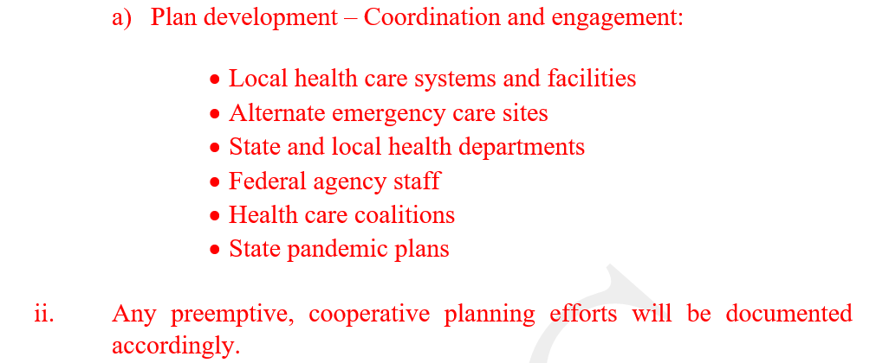
Monitoring and Reporting
Collaboration
Notes:
Identifying who you will coordinate / collaborate with…document everything.

Slide 42
Training
Initial training
Ongoing training
Demonstrate Knowledge
“Describe Your EP Program”
“Identify hazard events that were identified in your risk assessment, why they were included, and how the risk assessment was conducted.”
Notes:
Training and Testing requirements are found in 491.12(d). I still run into confusion over Training versus Testing, and it often results in deficiencies for clinics; as illustrated in the CMS statistics. Training is referring to the training of your written plan and risk assessments. The training has to be documented.

Slide 43
Testing
Full-scale Community-based exercise; and
A Tabletop exercise*
Risk Assessments
Participation
Scenarios
Documentation
Exemption
Notes:
Testing is in reference to the clinic’s participation in exercises that TEST their emergency plan. Testing is a separate action item to be documented through an After-Action Report and Improvement Plan methodology. Initial training of the clinic’s full emergency plan is required, then e/o year. I’m still a proponent of annual training, two years is a long time to have little, if any, exposure, but that’s the requirement. Ongoing training should take into account new employees or training of any plan updates. Training for updates can be specific just for the updated parts. You shouldn’t have to administer the entire plan.
Testing, as I mentioned, refers to the participation and completion of required exercises. The first requirement is a Full-scale Community-based exercise and the second is your choice. I listed a table top exercise here, but you can complete other types of exercises as your second exercise. A couple Provisions still apply to the Testing component… 1 – if you experience an actual emergency activation. I’ve spoken to a few surveyors about the pandemic recently and it seems the activation date or year is what they will use to determine to which full-scale the activation will apply…and 2 – if you can’t find a full-scale community-based exercise in your ‘community’ or timeframe needed, you can conduct a facility-based exercise instead of a community-based; keep in mind, it is still to be considered full-scale…so ‘boots on the ground.’ Not a sit-down discussion.
EID’s should be included. It’s recommended a plan be implemented to include all staff’s participation over a period of time. (identified as a cycle) Exercise scenarios should vary. No tornado and fire drill every year.
Exemption in testing refers to using an actual emergency to replace your full-scale exercise. Examples: 1135 Waivers, Alerts of the activation, facility closures, meeting minutes and AAR’s. Pretty simple I think, but it does lend to the idea that surveys are to be more stringent in their acceptance of what constitutes an emergency plan activation.

Slide 44
Policy Manual

Slide 45
Title 42 Part 491
“The Framework”
§491.4
Compliance with Federal, State and local laws.
Clinic licensure;
Clinic personnel are licensed, certified or registered in accordance with applicable laws.
Notes:
From Rural Health Clinic regs in Title 42 Part 491…what does the reg say about policy?
This part is as much evidence of compliance as it is policy, but if you plan to require staff to maintain their own BLS, for example, then it would be prudent to include policy spelling the expectation out so that ongoing policy training serves as a reminder. Also, if administrative personnel are expected to monitor the standard in addition, same reason.

Slide 46
42 CFR §491.7
Organizational Structure
Basic Requirements:
The clinic is under the medical direction of a physician, and has a health care staff that meets the requirements of §491.8;
Policies and lines of authority and responsibilities are clearly set forth in writing.
Disclosure:
Owners;
Person principally responsible for directing the operation of the clinic;
Person responsible for medical direction.
Notes:
I am going to hone in on the second bullet about lines of authority. This part includes a specific reference to policy, yet is general. We recommend an organizational chart specific to the clinic to meet this standard. If you are provider-based, then the lines of authority or org chart should pass up through the hospital’s leadership to meet standards in provider-based rules in part 413.65.
Under the second heading, Disclosures, we don’t always see a specific policy, but it’s usually evidenced, for instance, by a manual cover page that displays the name/ownership of the clinic and signature lines that identify the medical director and the operator.

Slide 47
42 CFR §491.8(b)
Staffing & Physician Responsibilities
Staffing requirements*;
Physician responsibilities:
Medical supervision of the health care staff;
In conjunction with the NP and/or PA member(s), participate in developing, executing, and periodically reviewing policies and services provided to Federal program patients;
Periodically review patient records, provides medical orders and care services to patients of the clinic.
Notes:
(a) Staffing. (1) The clinic or center has a health care staff that includes one or more physicians. Rural health clinic staffs must also include one or more physician's assistants or nurse practitioners.
(2) The physician member may be the owner, an employee, or under agreement.
(3) The PA, NP, nurse-midwife, CSW or clinical psychologist member may be the owner an employee, or under contract. In the case of a clinic, at least one PA or NP must be an employee of the clinic.
(4) The staff may also include ancillary personnel who are supervised by the professional staff.
(5) The staff is sufficient to provide the services essential to the operation of the clinic or center.
(6) A physician, NP, PA, certified nurse-midwife, CSW, or clinical psychologist is available to furnish patient care services at all times the clinic operates. In addition, for RHCs, a NP, PA, or CNM is available to furnish patient care services at least 50 percent of the time the RHC operates.

Slide 48
42 CFR §491.8(c), (c)(2)
Physician Assistant (PA) and Nurse Practitioner (NP) Responsibilities
Participate in the development, execution and periodic review of the policies;
Participate with the physician in a periodic review of the patients’ records.
Arrange for patient referral of services not provided in the clinic;
Assures patient health records are maintained and transferred upon referral.
Notes:
Either add a policy specific to the NP/PA job responsibilities or include these elements in their job description. REVIEW SLIDE.

Slide 49
42 CFR §491.9(b)(3)
Services
Policies include:
A description of services (arrangement or agreement);
Guidelines for medical management of health problems which include the conditions requiring medical consultation and/or patient referral, the maintenance of health care records, and procedures for periodic review and evaluation of services furnished;
Rules for storage, handling, and administration of drugs and biologicals.
Biennial review.*
Notes:
Services policies include…A description of the clinic’s services, medical management guidelines – Uphold and Graham, or I have seen a lot of practitioners moving to an online version, drug and biological management and our first regulatory update – biennial review as of 11/29/19.

Slide 50
42 CFR §491.9(b)(2)
Policy:
Policies are developed with the advice of a group of professional personnel that includes one or more physicians and one or more PAs or NPs.
*At least one member is not a member of the clinic.
Notes:
(b)(1) – Services furnished in accordance with written policies consistent with State law.
Again, I view this as evidence of compliance, but your policy doesn’t completely satisfy the standard if you don’t in some way illustrate this intent. The manual cover page includes the non-clinic member signature to accomplish this.

Slide 51
42 CFR §491.6(a), (b)
“The Big Three”
Physical Plant and Environment
Construction – Ensure access to and safety;
Maintenance – The clinic has a preventive maintenance program:
Equipment;
Drug and biological storage;
Clean and orderly.
Notes:
I call the next group of policies the big three…one, because it always seems to be findings within these requirements; it encompasses a broad spectrum of possible deficiencies…and two, because they result in the most frequent survey deficiencies.
The first and most broad of these is the Maintenance program. First, it starts with access and safety; which, in my opinion, implies ADA and OSHA standards. Second, it refers to equipment. So you need a policy that describes the inspections of electrical, mechanical and patient care equipment, frequency, etc.
Next, Drugs and biological storage…this is the second reference BTW…and the number 1 deficiency reported by CMS. The policy should describe not just storage, but also address monitoring, safety, inspection, BUD, CDC MDV / SDV, administration…obviously we capture both requirements in one policy.
Clean and orderly is the last in 491.6. So now we are adding cleaning policies. This may apply to staff that clean the clinic after hours, or it may address procedures for cleaning patient exam rooms, furniture, etc.
To sum it up, you may end up with a half dozen policies from this one short part.

Slide 52
42 CFR §491.9(c)(2)
Laboratory services for immediate diagnosis (part 493);
Chemical examination of urine by stick or tablet;
Hemoglobin or hematocrit;
Blood glucose;
Examination of stool specimens for occult blood;
Pregnancy tests; and
Primary culturing for transmittal to a certified laboratory.
Notes:
§ 493.3 Applicability.
(a)Basic rule. Except as specified in paragraph (b) of this section, a laboratory will be cited as out of compliance with section 353 of the
Public Health Service Act
unless it -
(1) Has a current, unrevoked or unsuspended certificate of waiver, registration certificate, certificate of compliance, certificate for PPM procedures, or certificate of accreditation issued by HHS applicable to the category of examinations or procedures performed by the laboratory; or
(2) Is CLIA-exempt.
The second of the big three is very specific to RHCs. This policy is necessity, but consider not just the requirement to offer these CLIA waived tests when the clinic is operating, but competencies, controls, lab equipment, extended testing, etc.

Slide 53
42 CFR §491.9(c)(3)
Emergency – The clinic provides medical emergency procedures as a first response to common life-threatening injuries and acute illness and has available the drugs and biologicals commonly used in life saving procedures, such as: (“The A Team”)
Analgesics;
Anesthetics (local);
Antibiotics;
Anticonvulsants;
Antidotes and emetics; and
Serums and toxoids.
Notes:
Another specific to RHCs in 491.9 is the emergency kit and procedures. Some of you may have a particular dislike for this requirement and it’s also another part that has some language changes. I want to point out the differences with this change though…this is an update to the interpretive guidance, while some of the other changes we are going to talk about are in the Title.
So, you need a policy that describes your emergency kit contents and monitoring procedures. We recommend a list applied to the outside of the kit with the contents and their expiration to expedite compliance inspection and further display intent to comply.

Slide 54
CMS Memo - Guidance
Ref: QSO-19-18-RHC September 3, 2019
The current guidance…an RHC must maintain a supply of drugs and biologicals adequate to handle the volume and type of emergencies it typically encounters for each of the listed categories.
If a RHC generally handles only a small volume/type of a specific emergency, store a small volume of a particular drug/biological.
Notes:
This is the current guidance for the emergency kit.

Slide 55
CMS Memo
Ref: Interpretive Guidance §491.9(c)(3) – J-0136
The RHC’s patient care policies are expected to address which drugs and biologicals it maintains for emergencies and in what quantities.
The RHC must maintain a supply of commonly used drugs and biologicals adequate to handle the volume and type of medical emergencies it typically encounters.
Notes:
An now the new guidance…READ SLIDE. We are still required to have an emergency kit.

Slide 56
42 CFR §491.9(d)
“Related to…”
Services provided through agreement or arrangement:
Inpatient hospital care;
Physician(s) services; and
Additional and specialized diagnostic and laboratory services.
*If not in writing, there is evidence patients referred are being accepted and treated.
Notes:
Referral process. Referral policy.

Slide 57
42 CFR §491.10(a)
Records system
The clinic maintains a clinical record system…
A designated member of the professional staff is responsible…;
In the medical record:
Identification and social data, consent forms, pertinent medical history, assessment of health status and needs of the patient, episode summary, disposition, and instructions to the patient;
Documented physical examination, diagnostic and lab results;
All physician’s orders, treatments, medications…;
Signatures.
Notes:
Anyone know what year the RHC Act was signed into effect?
1977…
Anyone know what year HIPAA became effective?
1996…
I think it’s very interesting that a niche provider like RHC’s really plowed the way for almost twenty years before everyone else was held to healthcare privacy standards.
Anyway, you should have a medical record policy for your RHC. Some of the specific requirements are summarized on the slide.

Slide 58
42 CFR §491.10(b)
Protection of information:
Confidentiality and safeguards against lost, destruction or unauthorized use;
Policy and Procedure for the use and removal; conditions for release of information;
Written consent.
Retention of records.
Notes:
And this slide…

Slide 59
42 CFR §491.11
Program Evaluation
Utilization of clinic services;
Chart review;
Policy review.
*Findings; Corrective action(s).
Notes:
491.11. I’m very disappointed they are moving this to a biennial requirement. For many years I have had fun with this acronym. I have yet to come up with a fun acronym for BPE. Your policy should include the provisions to include a non-clinic member, the evaluation ‘committee’ (medical director, mid-level, administrator), etc.

Slide 60
42 CFR §491.12
Emergency Preparedness
Emergency Plan;
Policies and procedures;
Communication Plan;
Training and testing; and
Integrated health systems.
Notes:
Everyone’s favorite and probably the most celebrated regulatory update…many of the requirements are also moving to biennial…particularly celebrated I think are the exercises…one each year instead of two… This is one of the more intensive and lengthy policies for those that haven’t had to be part of the policy writing team!

Slide 61
RHC Policy Overview
Compliance
◊ Compliance Plan
◊ Program Evaluation
◊ Emergency Preparedness
Administration
◊ Organization
◊ Personnel
◊ Records Management
Patient-Care
◊ Medical Guidelines
◊ Services
◊ Equipment, safety, cleaning
◊ Laboratory
◊ Emergency Procedures
◊ Drug/Biological Management
Notes:
Summary of RHC policies. Now I don’t want to get anyone excited with the few number of titles here…some of these represent a number of possible policies. For instance, your compliance plan will include policies like confidentiality, fraud, waste and abuse, maybe a compliance officer responsibility. Drug and biological management may have several policies like if your clinic has drug samples. It may be included together if you want, but there are some difference to address.

Slide 62
Are we done yet?
Administrative, organizational and compliance* policies
Human resources (OIG)
Financial & Billing
Office of Civil Rights
Physical Plant and Safety (OSHA / ADA / CDC)
Patient & Diagnostic services*
HIPAA
Vaccine Mandate
Other*
Notes:
Non RHC policies may be related to any of these categories listed.
Perhaps you are owned by a hospital and provider-based rules in section 413.65 apply; which may also affect many of these categories.
Maybe you have Radiology, EKG, Ultrasound, or Extended lab testing, an AED. All of these items or processes may be specific to your clinic.
Don’t forget the Feds this Holiday either…OCR / OIG / OSHA.

Slide 63
Survey Readiness
Notes:
When you see Expirations and PM at the top of the deficiency list… sometimes only an emoji can totally capture it!!! - ‘UGGGGHHH”

Slide 64
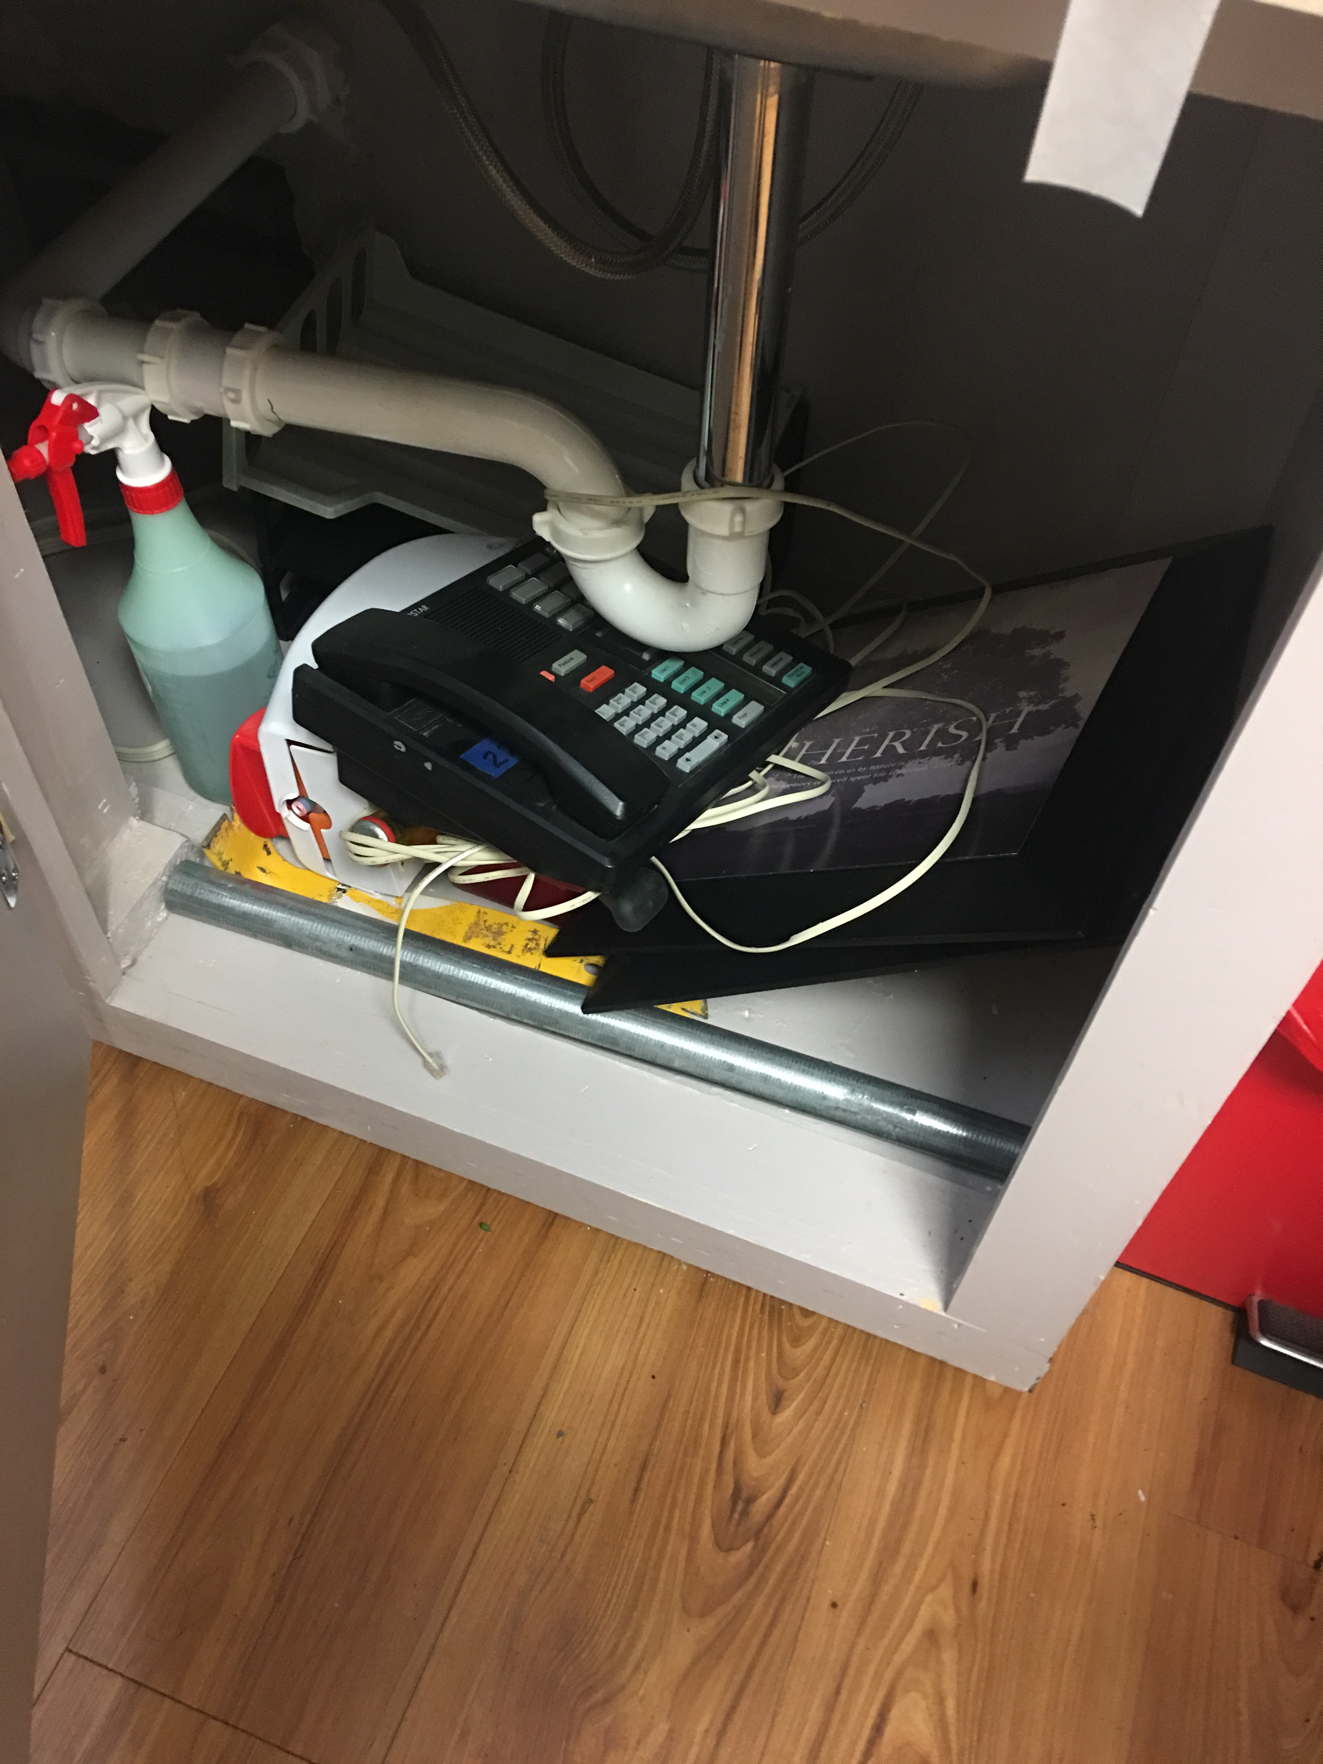
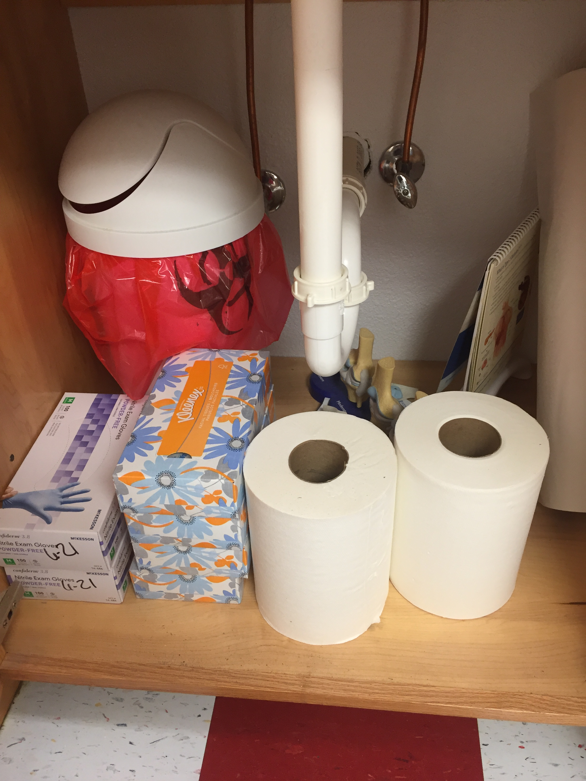
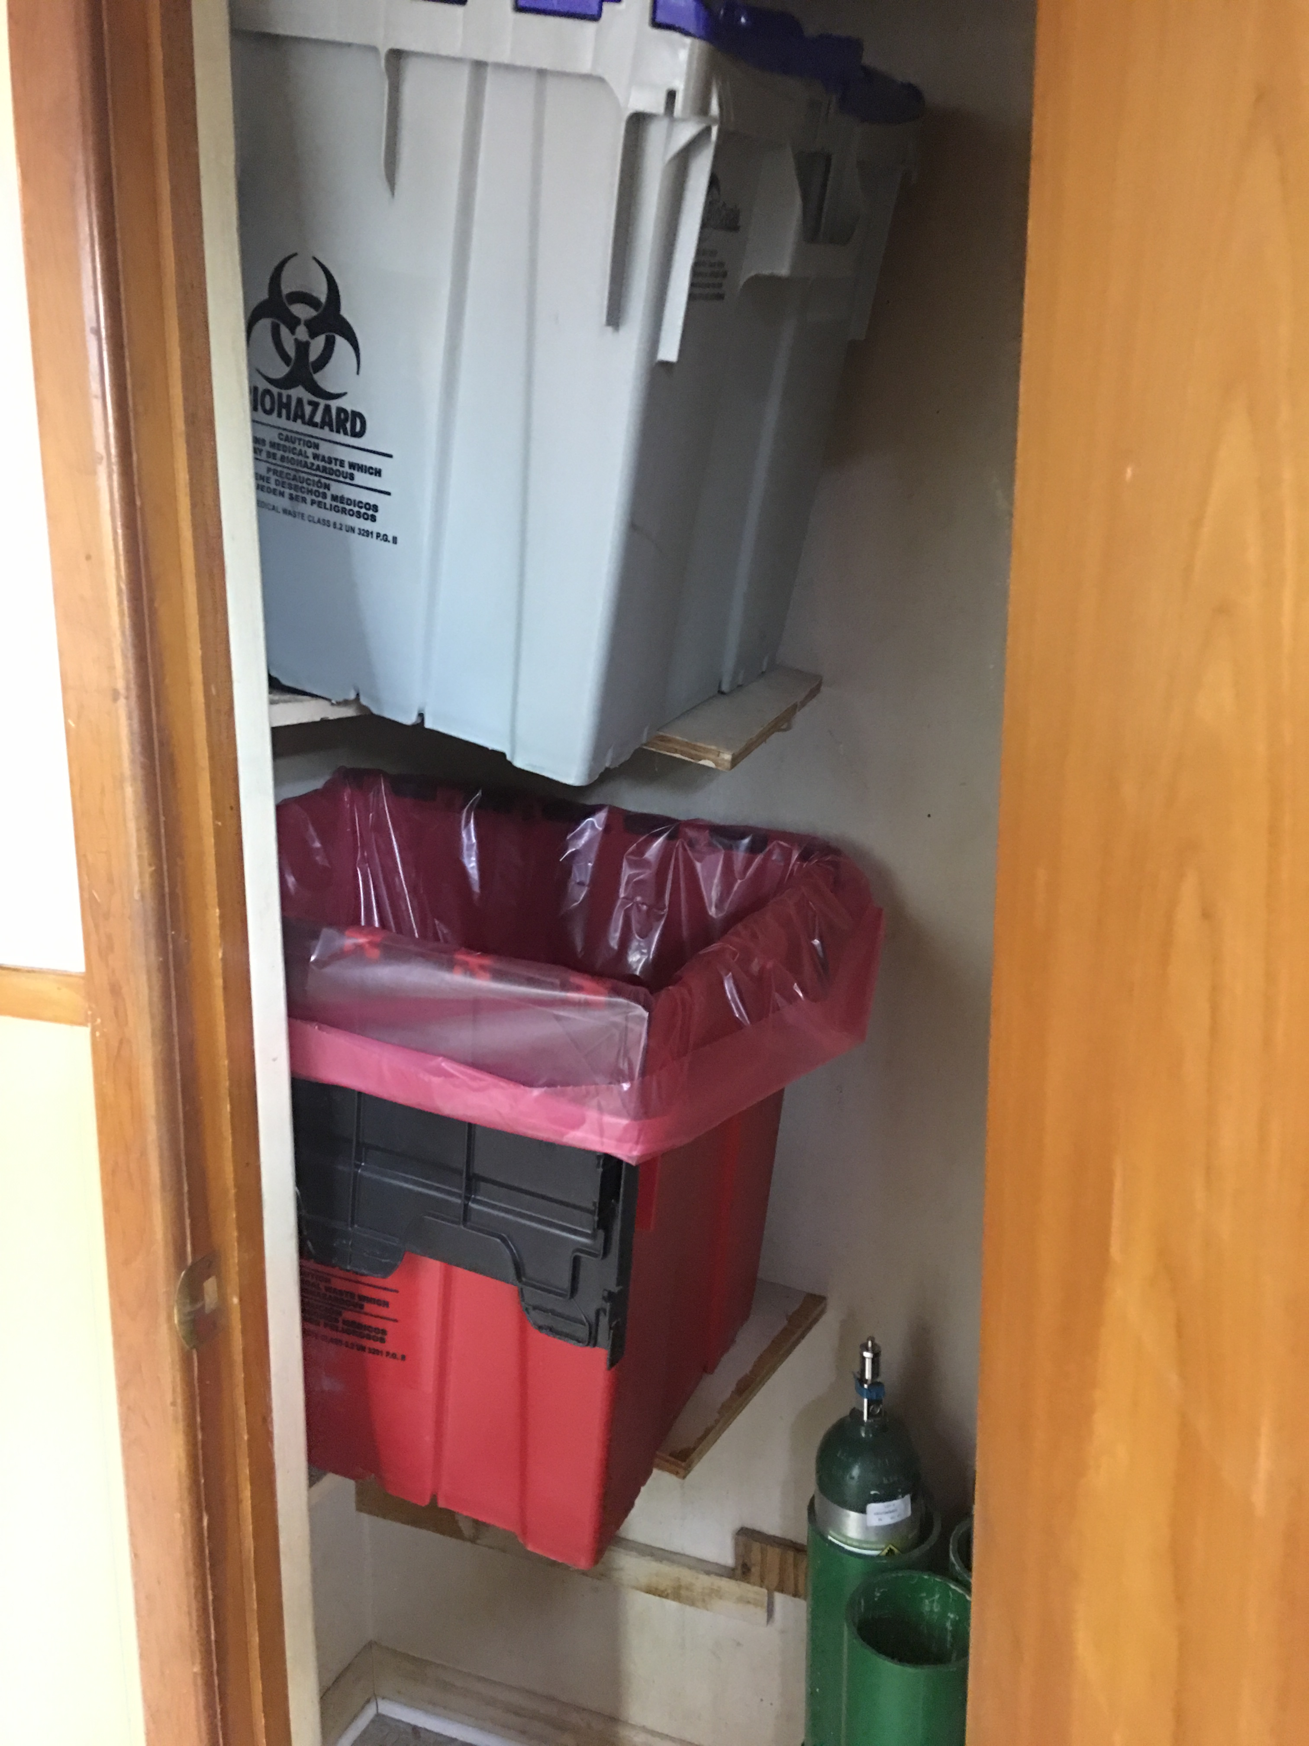
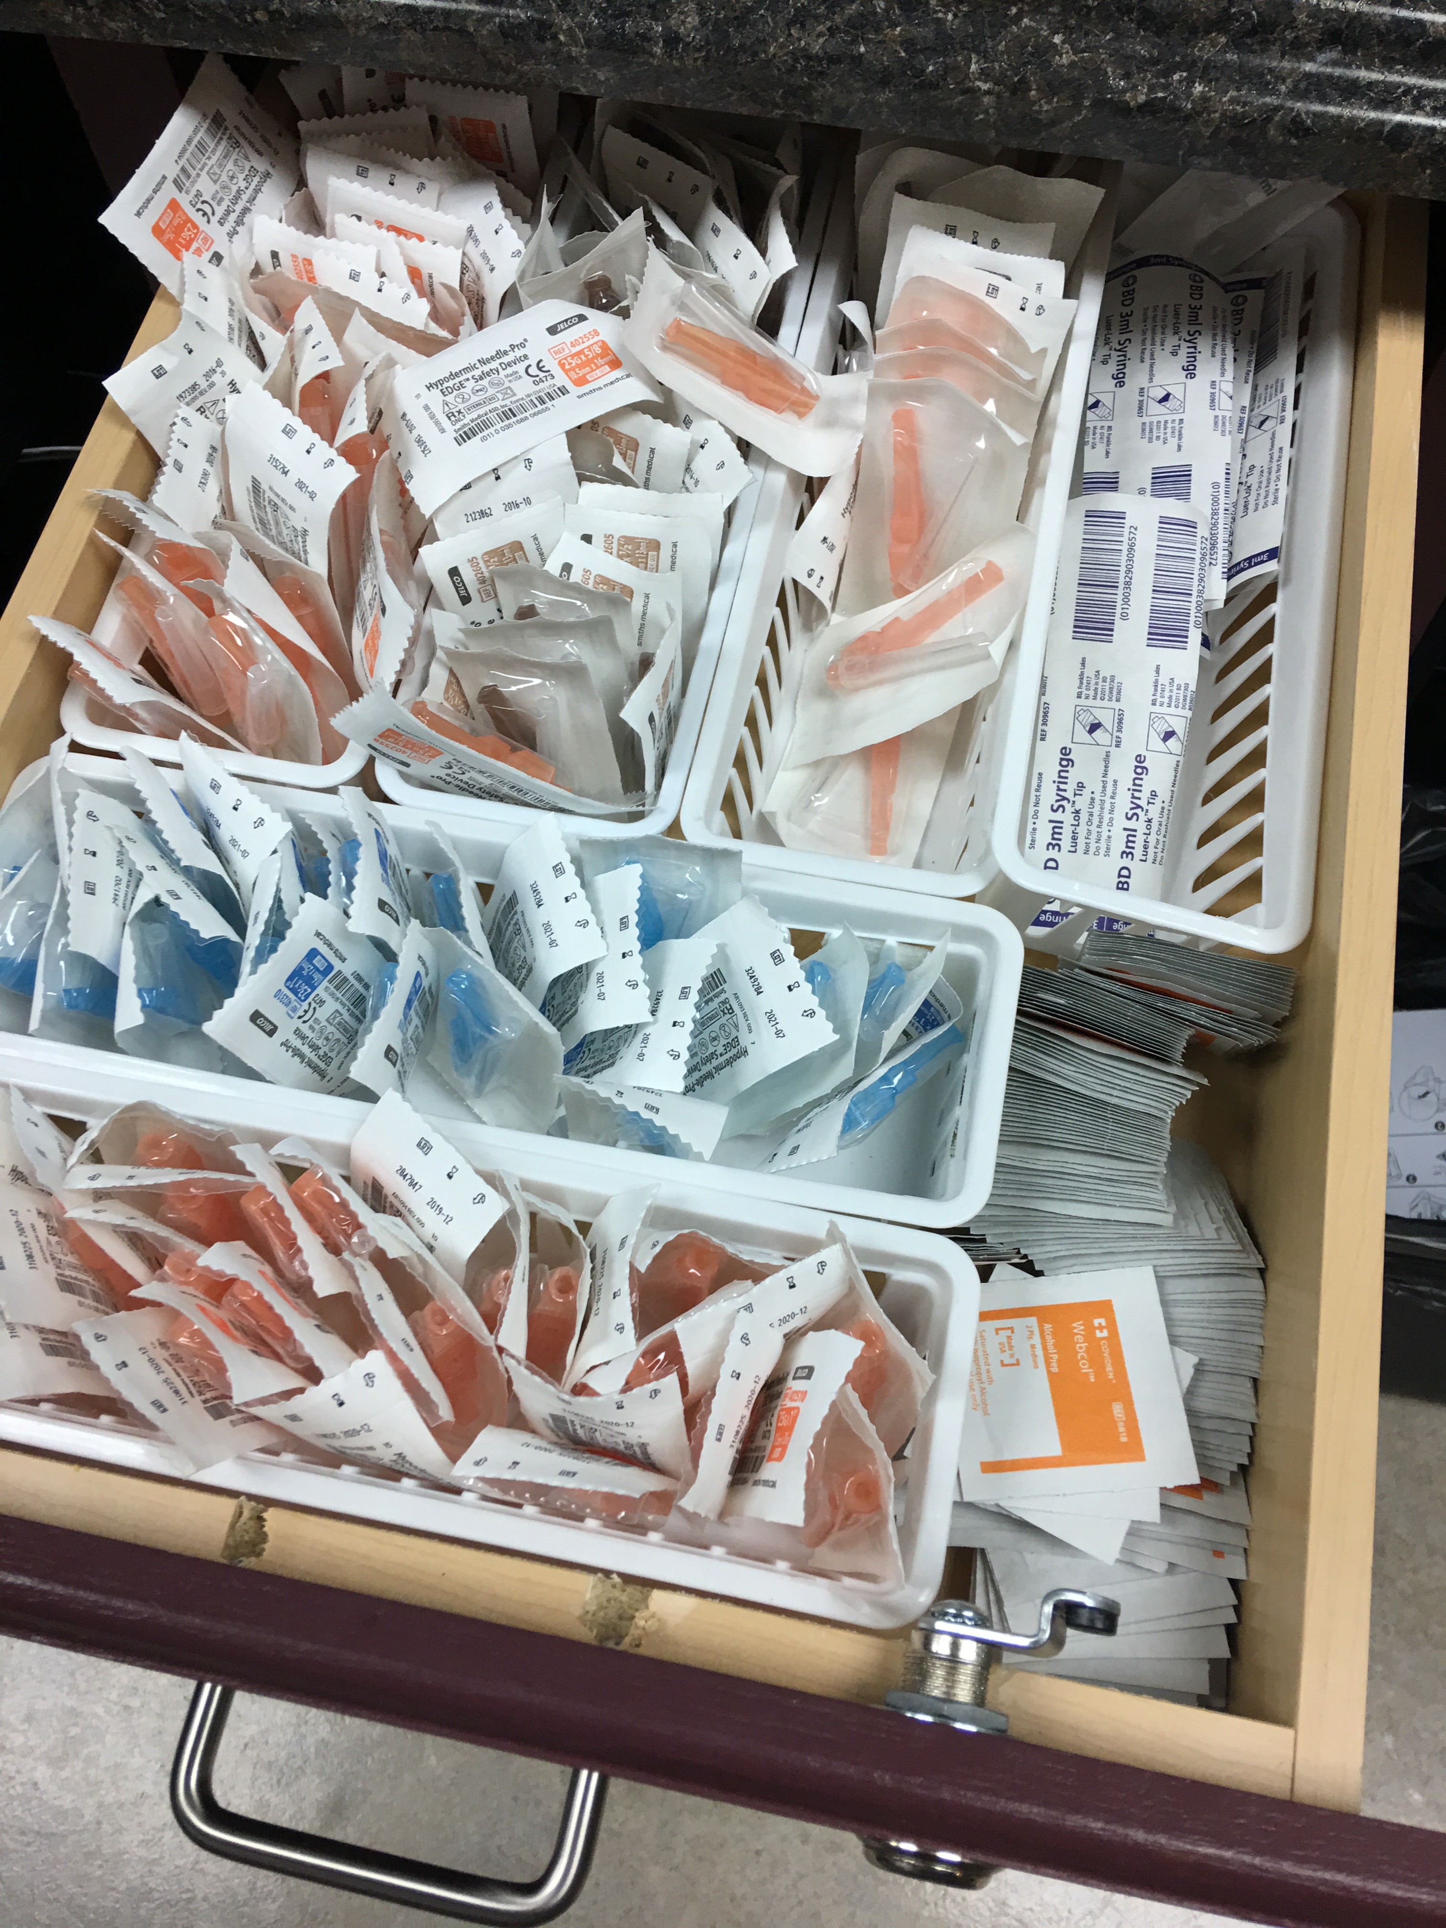
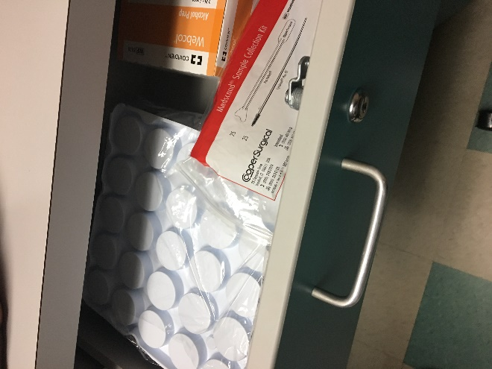
Survey Preparedness
Notes:
Speaking of the Turtle Train (toooot) derailing…Here are some real examples of when the turtle train derails! REVIEW SLIDE.
OK… Where’s waldo?
*The old Big Gulp in the medication fridge…
This next one was interesting…*the hazard containers wouldn’t fit on the shelves, so a board is balanced perpendicular to the shelf…Walla-insta OSHA hazard!! But even better, look below. Anyone ever watched an Oxygen tank launch?!!!
*Under sink storage like these offer infection control and electrical concerns…
And *the old formaldehyde in the bottom drawer of the exam table…
*The sliver canister was one of the more interesting finds…so you can’t see it but the unmarked canister has masking tape on it marked “1993.” So, I pull it down from three shelves high and open it. Pull out a bottle, you know how an old bottle inevitably gets the labels saturated and discolored?...yeah, that was what was in my hand…So I start reading the label and about ¾ down a 6 inch label printed in a 6-type font, it said “absorption through the skin may lead to death.” As I put the bottle on the counter, the only thing I could think is, “why did the manufacturer not lead with that statement.” as I washed my hands of course…Don’t you generally pick something up when you want to read something the size of a grain of sand?!!!!! Anyway…good times!!

Slide 65
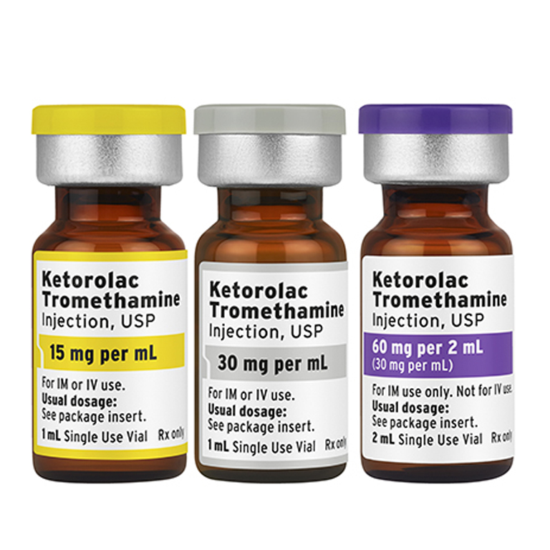
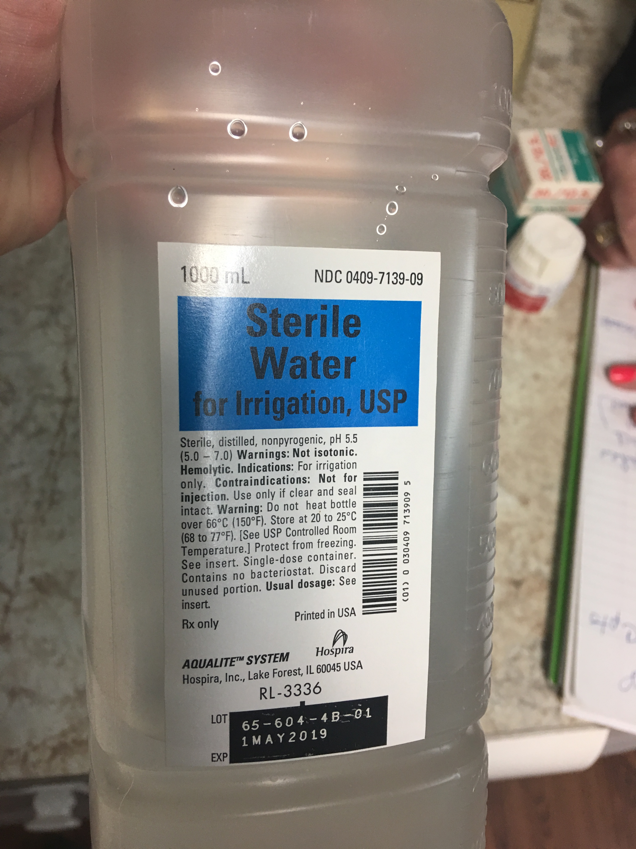
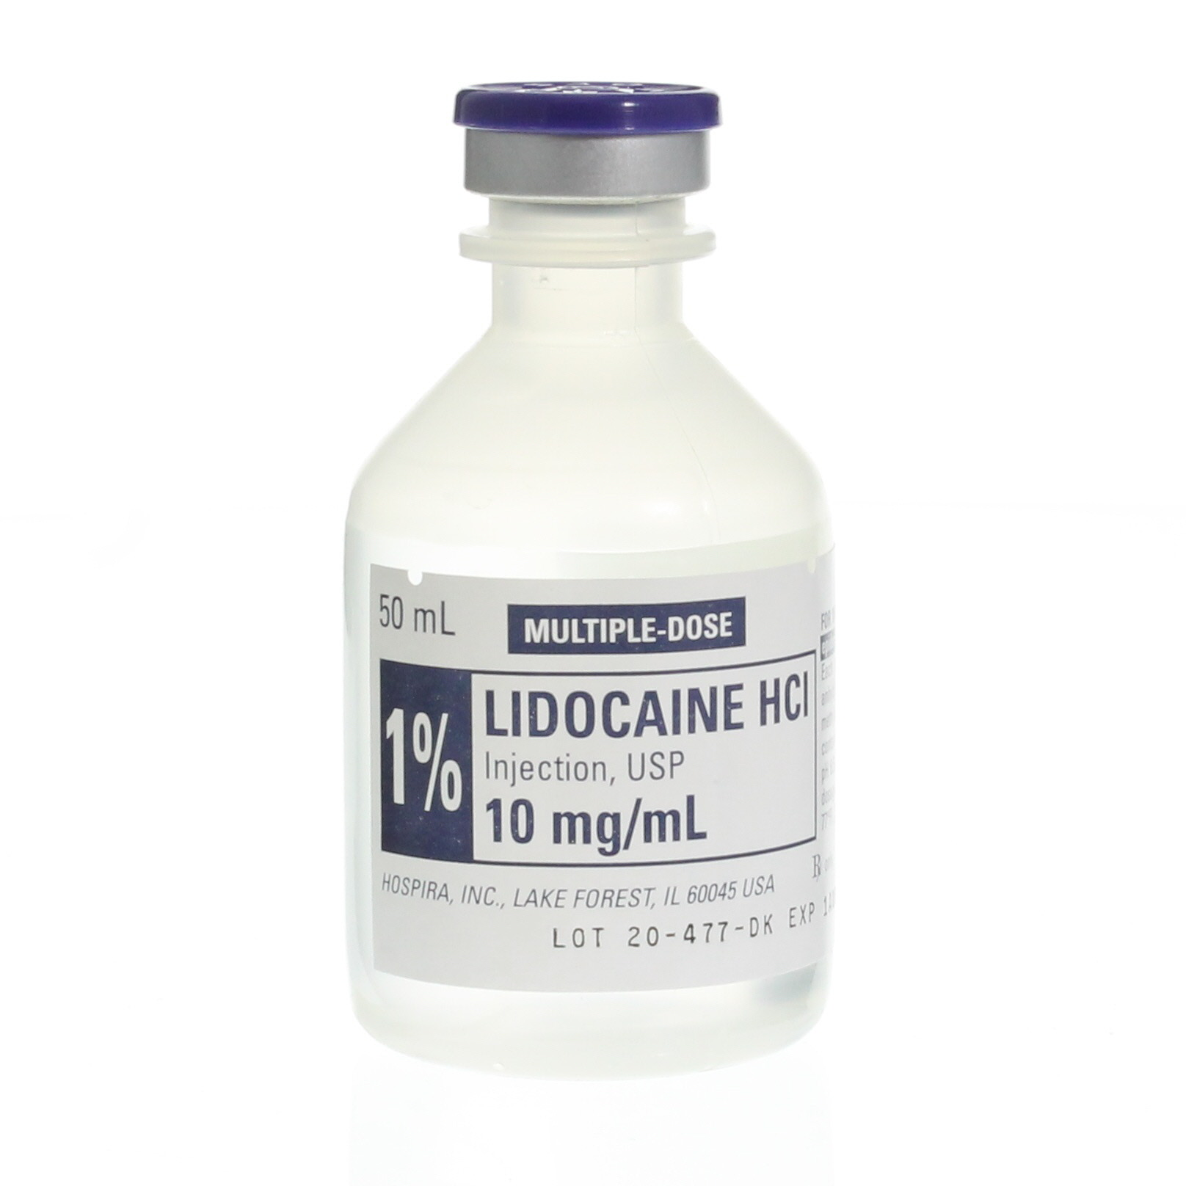
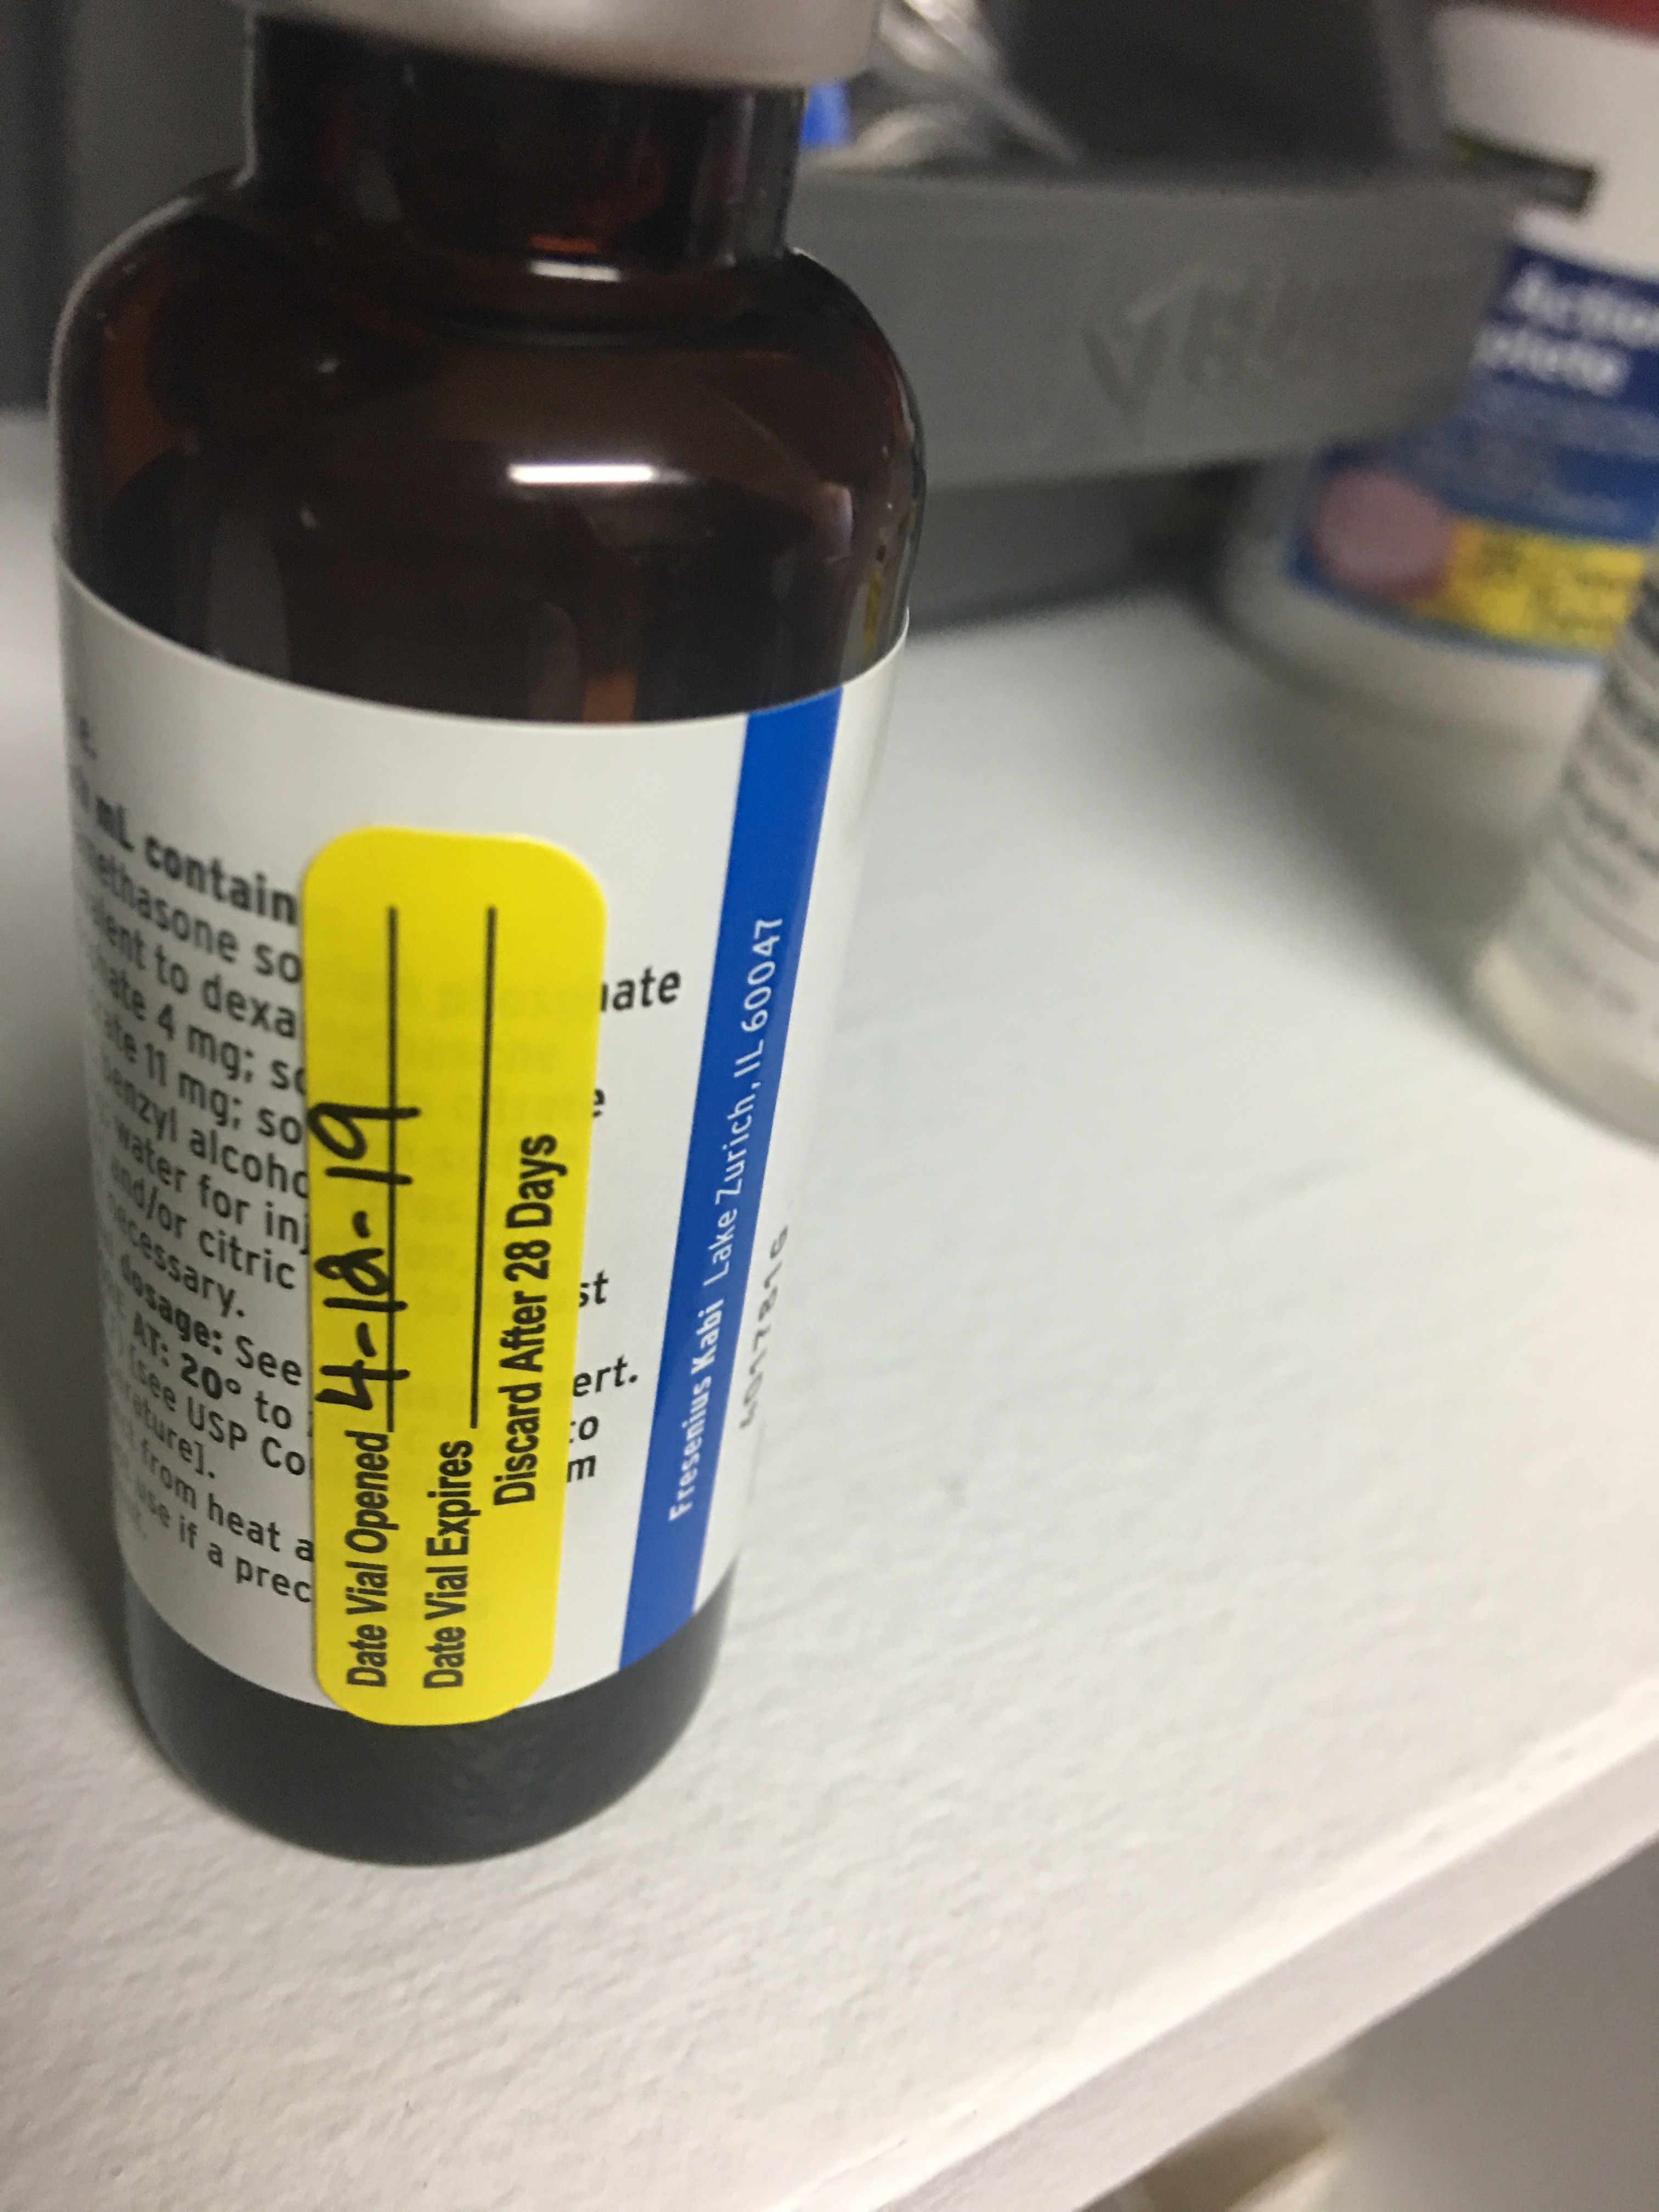
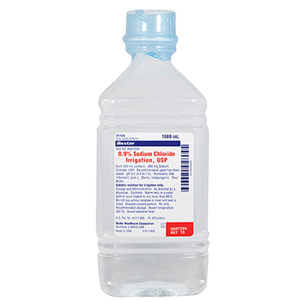
Survey Preparedness
Notes:
REVIEW SLIDE. Common deficiency issue to review and reinforce while you conduct your turtle train…MDVs and SDVs…

Slide 66
Survey Readiness: Survey
Maintain a state of survey readiness!
Be ready every day!
Notes:
REVIEW SLIDE. What are some ways to achieve survey Readiness?

Slide 67
Survey Readiness
Readiness Binder: includes program eval
Culture of Compliance – staff knowledge and competency (comprehension)
Common Deficiencies
MBWA & follow-up
Identify Gaps in Expectations
Documentation must be readily accessible
Organization – centralize, declutter
Systematic processes & Methods that demonstrate compliance and intent – ?
Teamwork makes the dream work
Educate, Audit, Inspect what you expect.
Notes:
REVIEW SLIDE. There’s that turtle train again…
Demonstrates compliance? – checklists, hopefully completed to date, writing expirations, ekit list on outside with expirations, labelled oxygen tanks, notcies…

Slide 68
Survey Preparedness: Survey
Place for the surveyor to work
Liaison to the Surveyor
Engage Staff
Access to medical records, policies, personnel records, certifications, registrations, BLS, etc. All EASILY available
Survey Results – Review!
Engage staff frequently!
Regulations – Read!
Be a PLEASER!!!!
Notes:
How can we plan for the actual day or days of a survey? REVIEW SLIDE.
Be a PLEASER! Yeah I made it up. I just pulled letters out where I needed them and moved words around to make the acronym work. But think about it…how can you make the process less stressful for you and more expedient for the surveyor…

Slide 69
Most Common Deficiencies
Medication Management
Single Dose vs Multi-Dose Vials
Drugs not secure
NP/PA not signing off on policies
Emergency Preparedness
No exercise or after-action report
No plan
No HVA
Chart Reviews missing
Infection Control
Missing policies
Expired Items
Notes:
How can we plan for the actual day or days of a survey? REVIEW SLIDE.
Be a PLEASER! Yeah I made it up. I just pulled letters out where I needed them and moved words around to make the acronym work. But think about it…how can you make the process less stressful for you and more expedient for the surveyor…

Slide 70
Credentialing & Enrollment, Medical Billing, RHC & Compliance Services
Mark Schultz, RN, BSN
Manager of Clinic Development & Research
mschultz@mwhc.net
(573) 450-3735 cell
(573) 335-4715 office
Don’t forget to sign up for Midwest Health Care’s Newsletter…
www.mwhc.net www.yourcredentialingpartner.com
Notes:
Thank you!

